Slide 1
Basics
Assembly Language Programming
Dr Emmanuel Ahene

Slide 2
Outline
Welcome to Assembly
Assembly-, Machine-, and High-Level Languages
Assembly Language Programming Tools
Programmer’s View of a Computer System
Basic Computer Organization

Slide 3
Goals and Required Background
Goals: broaden student’s interest and knowledge in …
  Basic organization of a computer system
  Intel IA-32 processor architecture
  How to write assembly language programs
  How high-level languages translate into assembly language
  Interaction between the assembly language programs, libraries, the operating system, and the hardware
  How interrupts, system calls, and handlers work
Required Background
  The student should already be able to program confidently in at least one high-level programming language, such as Java or C.

Slide 4
Grading Policy
Attendance 5%
Quizzes 5 %
Midsem Exam 20%
Final Exam 70%

Slide 5
Next …
Welcome
Assembly-, Machine-, and High-Level Languages
Assembly Language Programming Tools
Programmer’s View of a Computer System
Basic Computer Organization
Data Representation

Slide 6
Some Important Questions to Ask
What is Assembly Language?
Why Learn Assembly Language?
What is Machine Language?
How is Assembly related to Machine Language?
What is an Assembler?
How is Assembly related to High-Level Language?
Is Assembly Language portable?

Slide 7
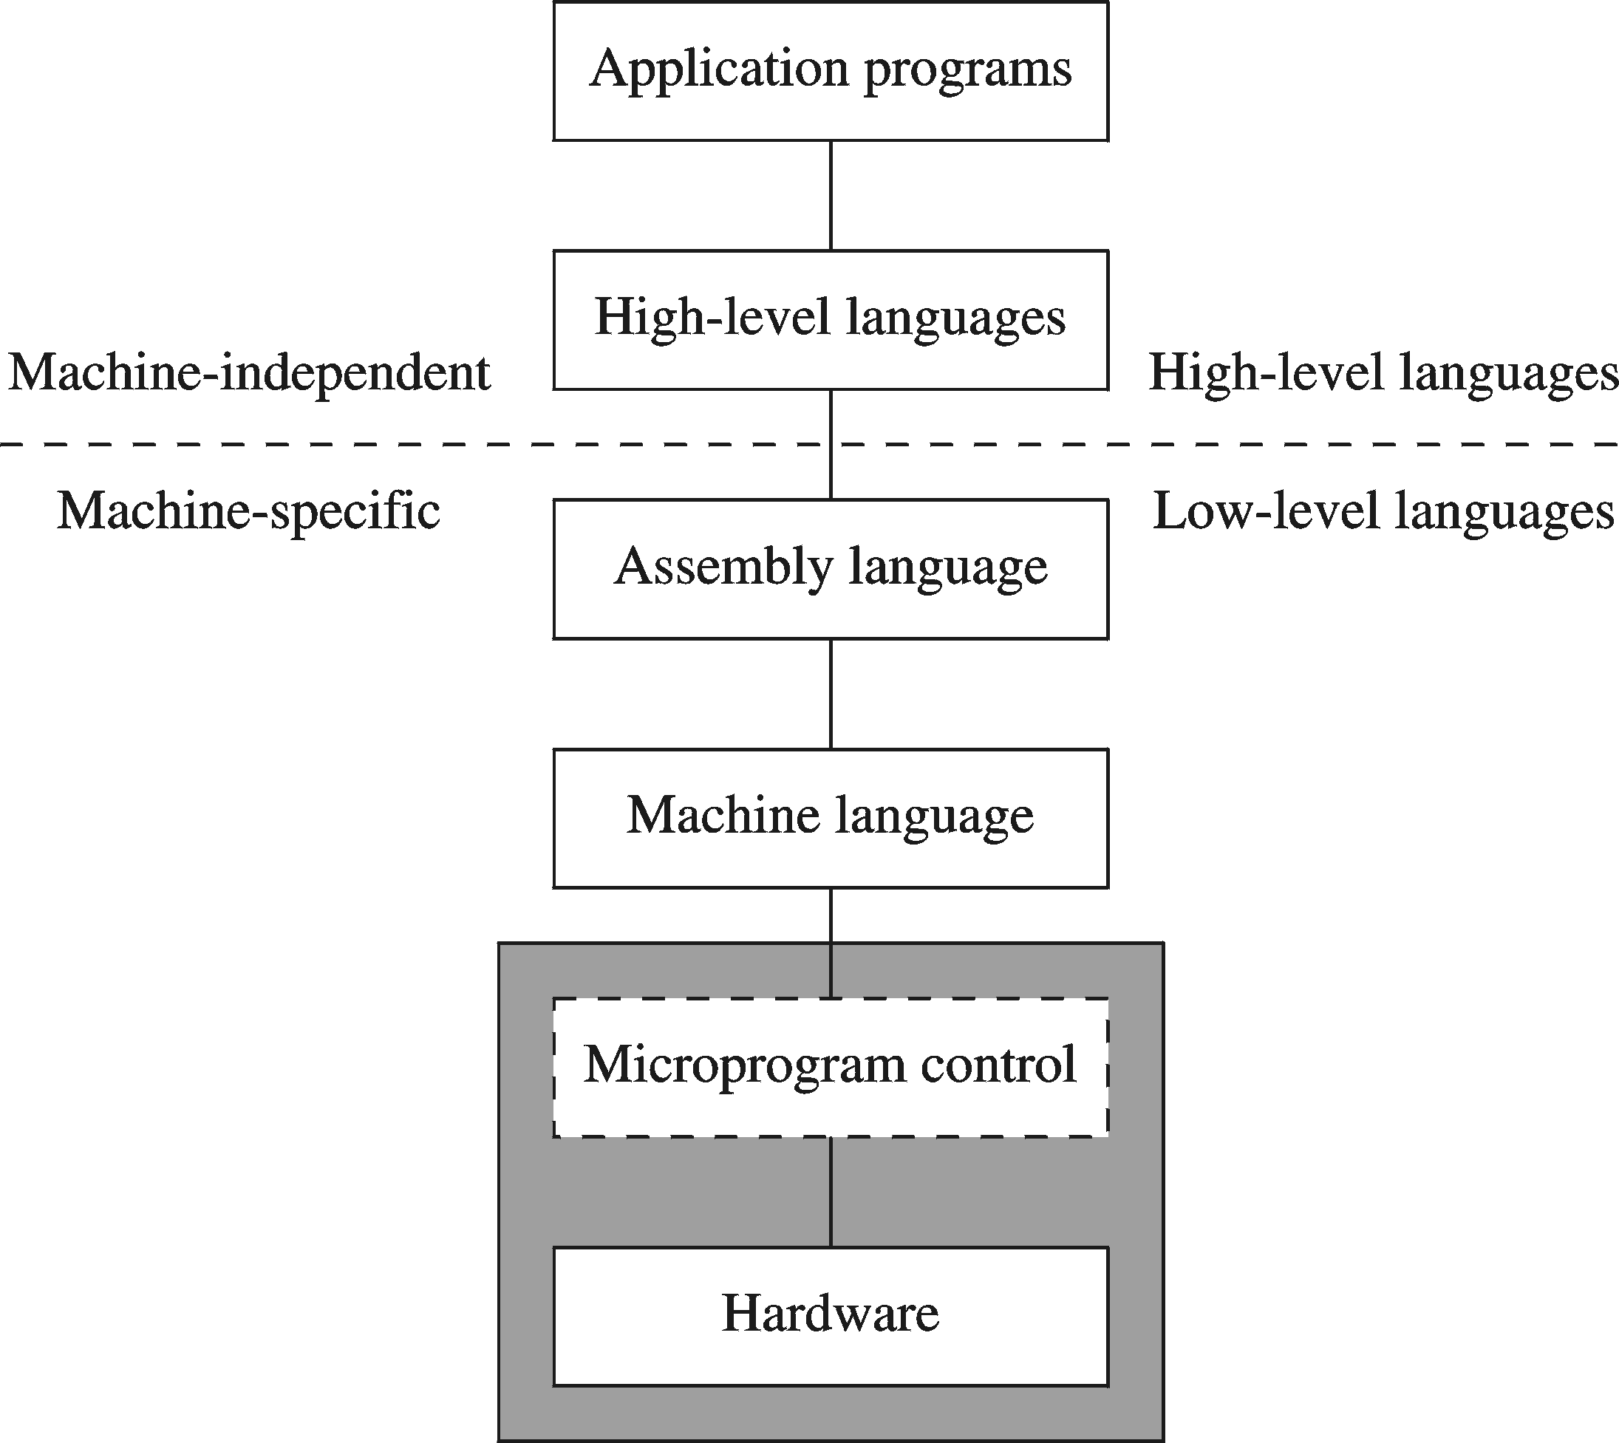
A Hierarchy of Languages

Slide 8
Assembly and Machine Language
Machine language
  Native to a processor: executed directly by hardware
  Instructions consist of binary code: 1s and 0s
Assembly language
  A programming language that uses symbolic names to represent operations, registers and memory locations.
  Slightly higher-level language
  Readability of instructions is better than machine language
  One-to-one correspondence with machine language instructions
Assemblers translate assembly to machine code
Compilers translate high-level programs to machine code
  Either directly, or
  Indirectly via an assembler

Slide 9
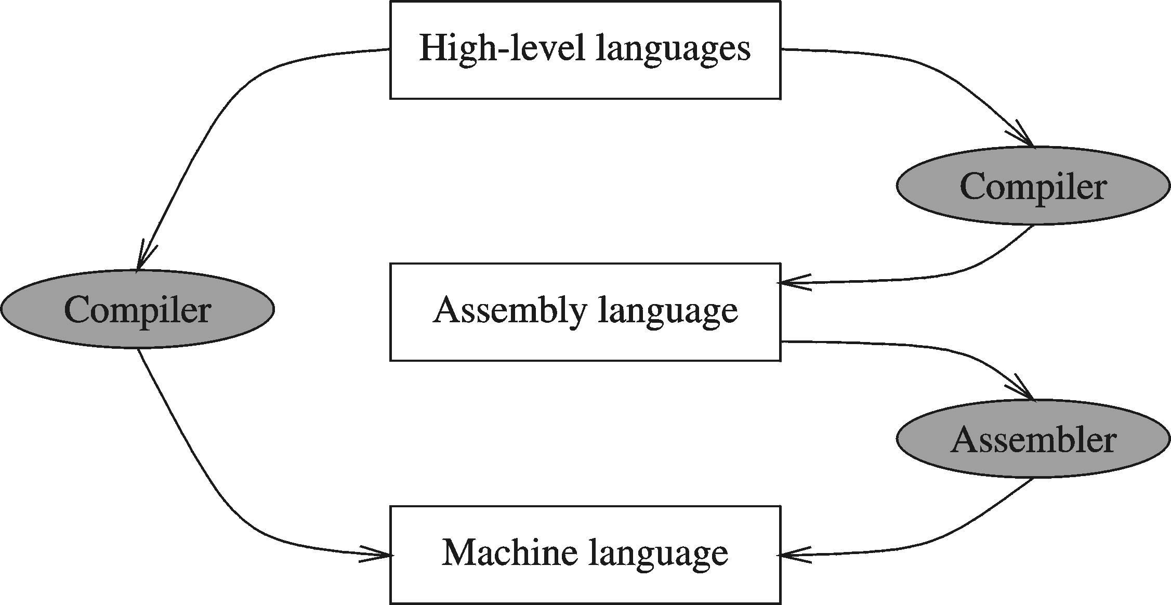
Compiler and Assembler

Slide 10
Instructions and Machine Language
Each command of a program is called an instruction (it instructs the computer what to do).
Computers only deal with binary data, hence the instructions must be in binary format (0s and 1s) .
The set of all instructions (in binary form) makes up the computer's machine language. This is also referred to as the instruction set.

Slide 11
Instruction Fields
Machine language instructions usually are made up of several fields. Each field specifies different information for the computer. The major two fields are:
Opcode field which stands for operation code and it specifies the particular operation that is to be performed.
  Each operation has its unique opcode.
Operands fields which specify where to get the source and destination operands for the operation specified by the opcode.
  The source/destination of operands can be a constant, the memory or one of the general-purpose registers.

Slide 12
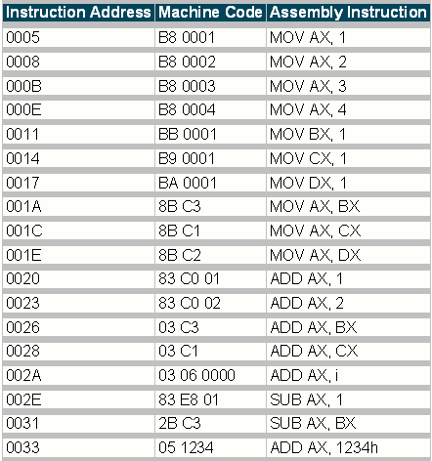
Assembly vs. Machine Code

Slide 13
Translating Languages
English: D is assigned the sum of A times B plus 10.
High-Level Language: D = A * B + 10
A statement in a high-level language is translated typically into several machine-level instructions
Intel Assembly Language:
mov eax, A
mul B
add eax, 10
mov D, eax
Intel Machine Language:
A1 00404000
F7 25 00404004
83 C0 0A
A3 00404008

Slide 14
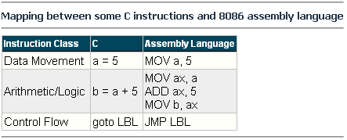
Mapping Between Assembly Language and HLL
Translating HLL programs to machine language programs is not a one-to-one mapping
A HLL instruction (usually called a statement) will be translated to one or more machine language instructions

Slide 15
Advantages of High-Level Languages
Program development is faster
  High-level statements: fewer instructions to code
Program maintenance is easier
  For the same above reasons
Programs are portable
  Contain few machine-dependent details
    Can be used with little or no modifications on different machines
  Compiler translates to the target machine language
  However, Assembly language programs are not portable

Slide 16
Why Learn Assembly Language?
Accessibility to system hardware
  Assembly Language is useful for implementing system software
  Also useful for small embedded system applications
Space and Time efficiency
  Understanding sources of program inefficiency
  Tuning program performance
  Writing compact code
Writing assembly programs gives the computer designer the needed deep understanding of the instruction set and how to design one
To be able to write compilers for HLLs, we need to be expert with the machine language. Assembly programming provides this experience

Slide 17
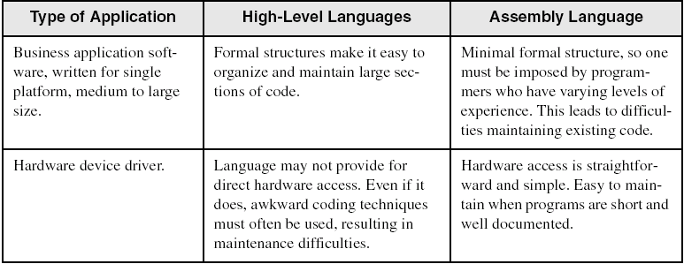
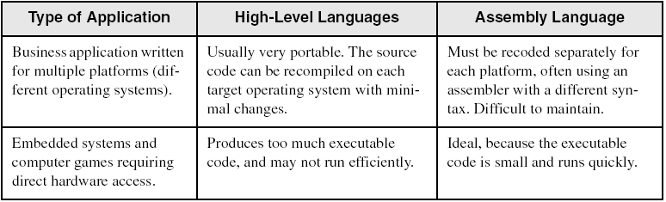
Assembly vs. High-Level Languages
Some representative types of applications:

Slide 18
Next …
Welcome
Assembly-, Machine-, and High-Level Languages
Assembly Language Programming Tools
Programmer’s View of a Computer System
Basic Computer Organization

Slide 19
Assembler
Software tools are needed for editing, assembling, linking, and debugging assembly language programs
An assembler is a program that converts source-code programs written in assembly language into object files in machine language
Popular assemblers have emerged over the years for the Intel family of processors. These include …
  TASM (Turbo Assembler from Borland)
  NASM (Netwide Assembler for both Windows and Linux), and
  GNU assembler distributed by the free software foundation

Slide 20
Linker and Link Libraries
You need a linker program to produce executable files
It combines your program's object file created by the assembler with other object files and link libraries, and produces a single executable program
LINK32.EXE is the linker program provided with the MASM distribution for linking 32-bit programs
We will also use a link library for input and output
Called Irvine32.lib developed by Kip Irvine
  Works in Win32 console mode under MS-Windows

Slide 21
Assemble and Link Process
Source
File
Assembler
Object
File
Source
File
Assembler
Object
File
Linker
Executable
File
Source
File
Assembler
Object
File
Link
Libraries
A project may consist of multiple source files
Assembler translates each source file separately into an object file
Linker links all object files together with link libraries

Slide 22
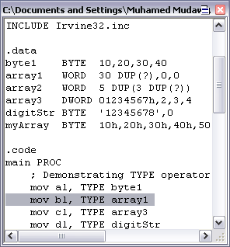
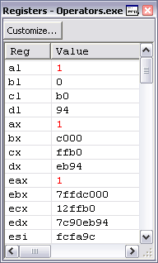
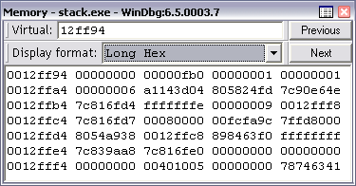
Debugger
Allows you to trace the execution of a program
Allows you to view code, memory, registers, etc.
Example: 32-bit Windows debugger

Slide 23
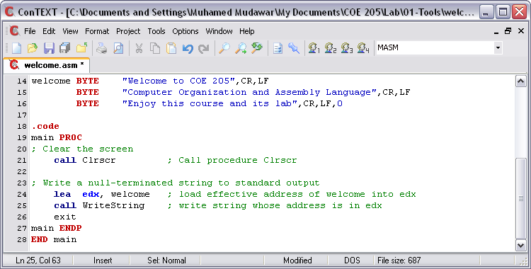
Editor
Allows you to create assembly language source files
Some editors provide syntax highlighting features and can be customized as a programming environment

Slide 24
Next …
Welcome
Assembly-, Machine-, and High-Level Languages
Assembly Language Programming Tools
Programmer’s View of a Computer System
Basic Computer Organization

Slide 25
Programmer’s View of a Computer System
Increased level of abstraction
Application Programs
High-Level Language
Level 5
Assembly Language
Level 4
Operating System
Level 3
Instruction Set
Architecture
Level 2
Microarchitecture
Level 1
Each level hides the details of the level below it
Digital Logic
Level 0

Slide 26
Programmer's View – 2
Application Programs (Level 5)
  Written in high-level programming languages
  Such as Java, C++, Pascal, Visual Basic . . .
  Programs compile into assembly language level (Level 4)
Assembly Language (Level 4)
  Instruction mnemonics are used
  Have one-to-one correspondence to machine language
  Calls functions written at the operating system level (Level 3)
  Programs are translated into machine language (Level 2)
Operating System (Level 3)
  Provides services to level 4 and 5 programs
  Translated to run at the machine instruction level (Level 2)

Slide 27
Programmer's View – 3
Instruction Set Architecture (Level 2)
  Specifies how a processor functions
  Machine instructions, registers, and memory are exposed
  Machine language is executed by Level 1 (microarchitecture)
Microarchitecture (Level 1)
  Controls the execution of machine instructions (Level 2)
  Implemented by digital logic (Level 0)
Digital Logic (Level 0)
  Implements the microarchitecture
  Uses digital logic gates
  Logic gates are implemented using transistors

Slide 28
Instruction Set Architecture (ISA)
Collection of assembly/machine instruction set of the machine
Machine resources that can be managed with these instructions
  Memory
  Programmer-accessible registers.
Provides a hardware/software interface

Slide 29
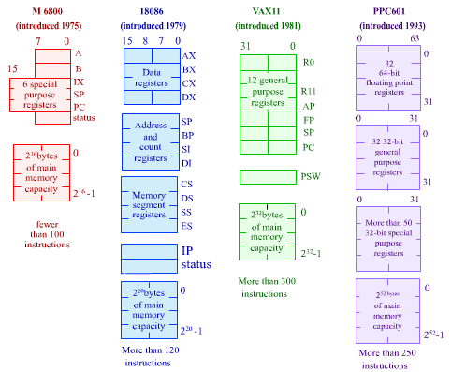
Instruction Set Architecture (ISA)

Slide 30
Next …
Welcome
Assembly-, Machine-, and High-Level Languages
Assembly Language Programming Tools
Programmer’s View of a Computer System
Basic Computer Organization

Slide 31
Basic Computer Organization
Since the 1940's, computers have 3 classic components:
  Processor, called also the CPU (Central Processing Unit)
  Memory and Storage Devices
  I/O Devices
Interconnected with one or more buses
Bus consists of
  Data Bus
  Address Bus
  Control Bus
data bus
registers
Processor
(CPU)
Memory
I/O
I/O
Device
Device
#1
#2
ALU
CU
clock
control bus
address bus

Slide 32
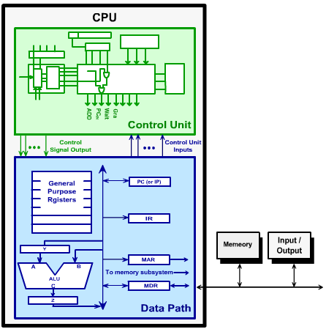

Processor (CPU)
Processor consists of
  Datapath
    ALU
    Registers
  Control unit
ALU
  Performs arithmetic
  and logic instructions
Control unit (CU)
  Generates the control signals required to execute instructions
Implementation varies from one processor to another

Slide 33
Clock
Synchronizes Processor and Bus operations
Clock cycle = Clock period = 1 / Clock rate
Clock rate = Clock frequency = Cycles per second
  1 Hz = 1 cycle/sec 1 KHz = 10³ cycles/sec
  1 MHz = 10⁶ cycles/sec 1 GHz = 10⁹ cycles/sec
  2 GHz clock has a cycle time = 1/(2×10⁹) = 0.5 nanosecond (ns)
Clock cycles measure the execution of instructions
Cycle 1
Cycle 2
Cycle 3

Slide 34
Memory
Ordered sequence of bytes
  The sequence number is called the memory address
Byte addressable memory
  Each byte has a unique address
  Supported by almost all processors
Physical address space
  Determined by the address bus width
  Pentium has a 32-bit address bus
    Physical address space = 4GB = 2³² bytes
  Itanium with a 64-bit address bus can support
    Up to 2⁶⁴ bytes of physical address space

Slide 35
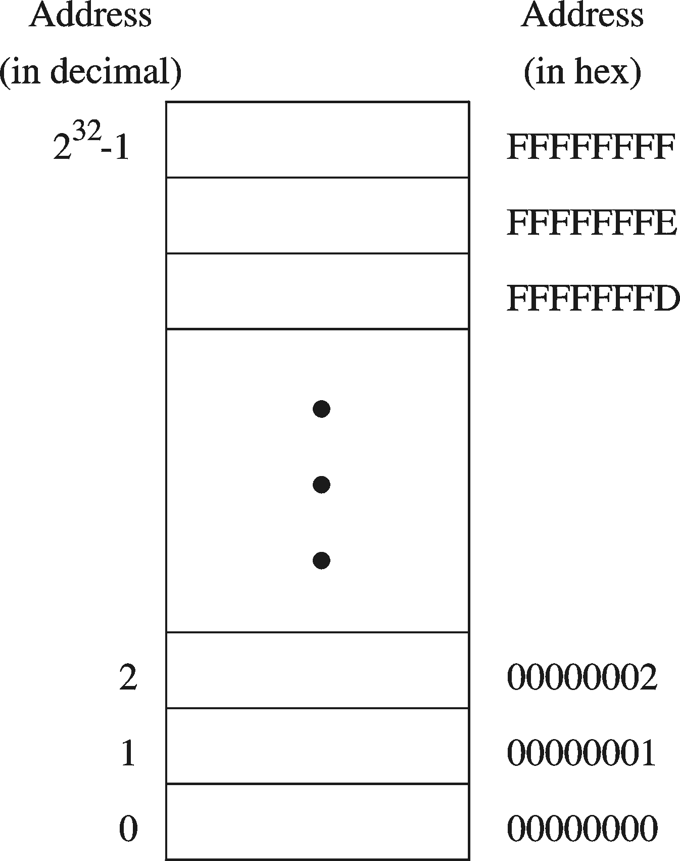
Address Space
Address Space is the set of memory locations (bytes) that can be addressed

Slide 36
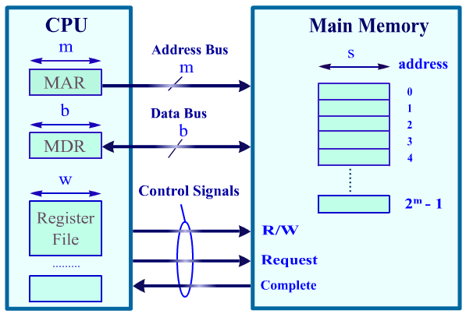
CPU Memory Interface
Address Bus
  Memory address is put on address bus
  If memory address = m bits then 2^{m} locations are addressed
Data Bus: b-bit bi-directional bus
  Data can be transferred in both directions on the data bus
  Note that b is not necessary equal to w or s. So data transfers might take more than a single cycle (if w > b) .
Control Bus
  Signals control
  transfer of data
  Read request
  Write request
  Complete transfer

Slide 37

Memory Devices
Random-Access Memory (RAM)
  Usually called the main memory
  It can be read and written to
  It does not store information permanently (Volatile , when it is powered off, the stored information are gone)
  Information stored in it can be accessed in any order at equal time periods (hence the name random access)
  Information is accessed by an address that specifies the exact location of the piece of information in the RAM.
  DRAM = Dynamic RAM
    1-Transistor cell + trench capacitor
    Dense but slow, must be refreshed
    Typical choice for main memory
  SRAM: Static RAM
    6-Transistor cell, faster but less dense than DRAM
    Typical choice for cache memory

Slide 38

Memory Devices
ROM (Read-Only-Memory)
  A read-only-memory, non-volatile i.e. stores information permanently
  Has random access of stored information
  Used to store the information required to startup the computer
  Many types: ROM, EPROM, EEPROM, and FLASH
  FLASH memory can be erased electrically in blocks
Cache
  A very fast type of RAM that is used to store information that is most frequently or recently used by the computer
  Recent computers have 2-levels of cache; the first level is faster but smaller in size (usually called internal cache), and the second level is slower but larger in size (external cache).

Slide 39
Processor-Memory Performance Gap
CPU: 55% per year
1000
“Moore’s Law”
100
Processor-Memory
Performance Gap:
(grows 50% per year)
Performance
10
DRAM: 7% per year
1
1981
1982
1983
1984
1985
1986
1987
1988
1989
1990
1991
1992
1993
1994
1995
1996
1997
1998
1980
1999
2000
1980 – No cache in microprocessor
1995 – Two-level cache on microprocessor

Slide 40
The Need for a Memory Hierarchy
Widening (expand) speed gap between CPU and main memory
  Processor operation takes less than 1 ns
  Main memory requires more than 50 ns to access
Each instruction involves at least one memory access
  One memory access to fetch the instruction
  Additional memory accesses for instructions involving memory data access
Memory bandwidth limits the instruction execution rate
Cache memory can help bridge the CPU-memory gap
Cache memory is small in size but fast

Slide 41
Typical Memory Hierarchy
Registers are at the top of the hierarchy
  Typical size < 1 KB
  Access time < 0.5 ns
Level 1 Cache (8 – 64 KB)
  Access time: 0.5 – 1 ns
L2 Cache (512KB – 8MB)
  Access time: 2 – 10 ns
Main Memory (1 – 2 GB)
  Access time: 50 – 70 ns
Disk Storage (> 200 GB)
  Access time: milliseconds
Microprocessor
Registers
L1 Cache
L2 Cache
Faster
Memory Bus
Bigger
Memory
I/O Bus
Disk, Tape, etc

Slide 42
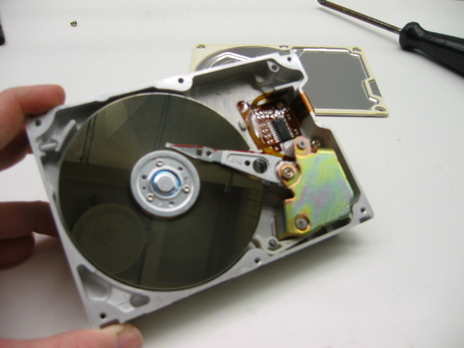
Magnetic Disk Storage
Disk Access Time =
Seek Time +
Rotation Latency +
Transfer Time
Sector
Read/write head
Actuator
Recording area
Seek Time: head movement to the desired track (milliseconds)
Rotation Latency: disk rotation until desired sector arrives under the head
Transfer Time: to transfer data
Track 2
Track 1
Track 0
Arm
Direction of rotation
Platter
Spindle

Slide 43
Example on Disk Access Time
Given a magnetic disk with the following properties
  Rotation speed = 7200 RPM (rotations per minute)
  Average seek = 8 ms, Sector = 512 bytes, Track = 200 sectors
Calculate
  Time of one rotation (in milliseconds)
  Average time to access a block of 32 consecutive sectors
Answer
  Rotations per second
  Rotation time in milliseconds
  Average rotational latency
  Time to transfer 32 sectors
  Average access time
  = 7200/60 = 120 RPS
= 1000/120 = 8.33 ms
= time of half rotation = 4.17 ms
= (32/200) * 8.33 = 1.33 ms
= 8 + 4.17 + 1.33 = 13.5 ms

